Slide 1
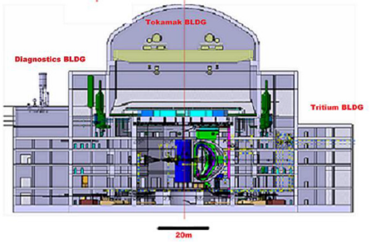
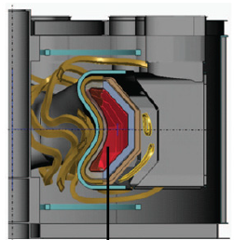
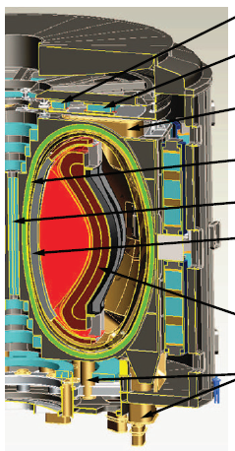
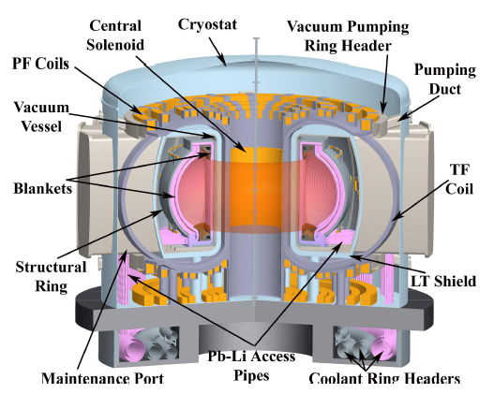
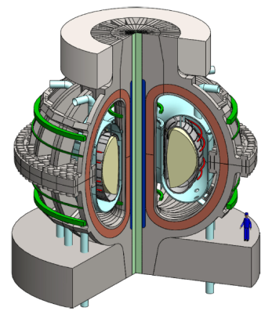
Integrated optimization of (toroidal magnetic) fusion power plants
Walter Guttenfelder
Princeton Plasma Physics Laboratory
SULI 2020
June 23, 2020
Notes:
These are not to scale! Lest I offend anyone ;)

Slide 2
Goals of this talk
Summarize and compile key constraints (nuclear, engineering, plasma physics) and inter-dependencies that influence conceptual design of fusion power plants & pilot plants
  Use that information to inform where innovations can make a difference
Provide examples of 0D “systems analysis” and conceptual design studies (as time allows)
  Highlight some of the front-end choices and assumptions that influence results
Further reading (& many figures taken from the following):
J. Friedberg, Phys. Plasmas 22, 070901 (2015) ← tutorial style introduction
C. Kessel, Fusion Sci. Tech 67, 1 (2015) (and the entire January 2015 issue) [ARIES-ACT power plant study]
All ARIES studies (http://aries.ucsd.edu/ARIES/) [Many ARIES power plant studies]
B. Sorbom, Fusion Engineering and Design 100, 378 (2015) [ARC HTS pilot plant]
A. Kuang, Fusion Engineering and Design 137, 221 (2018) [ARC HTS pilot plant]
J.E. Menard, Nuclear Fusion 56, 106023 (2016), Phil. Trans. R. Soc A (2019) [Low-A HTS pilot plant]
M. Kovari, Fusion Engineering and Design 89, 3054 (2014) [PROCESS systems code - physics]
M. Kovari, Fusion Engineering and Design 104, 9 (2016) [PROCESS systems code - engineering]
H. Zohm, Nuclear Fusion 57, 086002 (2017) (+ many others) [ITER → EU-DEMO analysis]
G. Federici, Nuclear Fusion 59, 066013 (2019) (+ many others) [EU-DEMO considerations]

Slide 3
A non-engineered, turbulent path: From engineering, to turbulence, to fusion plasmas, to plasma turbulence (and maybe back to engineering … one day?)
“I come from Des Moines. Somebody had to.” (The Lost Continent, B. Bryson)
Studied electrical engineering at Milwaukee School of Engineering – I loved analog circuits (I was a wannabe audiophile)
Discovered the beauty & magic of Maxwell’s equations → definitely going to grad. school
But I got distracted by fluid dynamics, thermodynamics & aerodynamics
Studied turbulent flames using laser induced fluorescence (Purdue University) → intro to turbulence
Turbulent flames are fascinating, but I missed my Maxwell’s Equations → Plasma!
Did my Ph.D. at the University of Wisconsin – Madison on HSX stellarator (see Bader talk, Day 4)
Realized turbulence was an important research topic in magnetized fusion plasmas → HOOKED!
Post-docs at U. Warwick (UK) & PPPL → spherical tokamak research (MAST, NSTX)
I spend a lot of time babysitting supercomputer simulations solving nonlinear 5D gyrokinetic-Maxwell equations, analyzing data, and comparing the two to validate predictions, develop transport models
But … sometimes I miss engineering “realities” (I suppose this is how I got myself roped into giving this talk … Arturo!)

Slide 4
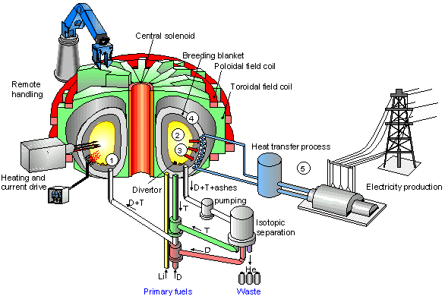
Schematic of a fusion power plant
Fusion core (magnets, plasma)
Blanket (neutron capture, tritium breeding)
Divertor/PFCs
Heating & current drive
Tritium processing and fueling
Power conversion
Maintenance scheme and waste

Slide 5
Conceptual design studies make front-end decisions and assumptions, then optimize remaining inter-dependencies
Define mission deliverables like P_{e,net}, availability, cost metrics, e.g.
  Nth-of-a-kind power plant with competitive COE
  Demonstration reactor (DEMO), validate all systems expected for power plant
  Pilot plant that produces net electricity, establishes capability for high average power output, demonstrates safe production and handling of tritium as well as feasibility of a closed fuel cycle (2019/2020 Community Planning Process Report)
Choose a core architecture (steady-state tokamak, pulsed tokamak, stellarator, inertial fusion, …),
Other elements might be assumed up front (blanket materials, heating scheme, …), ideally perform “trade” study to quantify impact
Methodology: Start with 0D “systems studies” (today’s talk), validate design points with higher fidelity analysis, iterate

Slide 6
Power plant vs. pilot plant considerations
A number of essential criteria for attractive power plants have been identified [El-Guebaly]
  Economically competitive cost-of electricity (COE); load-following capacity and range of unit sizes; High system availability; Tritium self-sufficiency with closed fuel cycle; Radiation-resistant materials for long lifetime; RAMI (Reliability, availability, maintainability, inspectability); Easy to license; Intrinsic safety; Integral radioactive waste management and decommissioning plan
Many international partners are pursuing “DEMO” reactors to demonstrate many of the above
  Using most mature (least risky) technologies and physics assumptions generally leads to very large power plants (R~9 m tokamaks, up to R~20 m stellarators)
Recent US vision* to pursue as a mission a pilot plant at low capital cost, perceived to be more attractive to development within the US energy market
  Emphasis on raising “Technical Readiness” of low-maturity innovations to lower capital cost
Recent call by DOE for NAS to perform a “fast-track” U.S. Compact Pilot Plant study to: (1) identify key goals for pilot plant; (2) list principle innovations needed for private sector to address, perhaps in concert with DOE efforts
Umstattd, Day 1
Mumgaard, Day 8
*NAS Burning Plasma report (2018), APS-DPP Community Planning Process report 2019/2020

Slide 7
Simple block diagram of plant power balance
P_{recirculating}
Fusion power plant
Q_{eng}=P_{net electric}/P_{recirculating}
P_{net electric}
P_{gross} _{elec.}

Slide 8
Simple block diagram of plant power balance
Plasma heating, coils / cryo, pumps, T processing, plant, …
P_{recirculating}
Q_{p}=P_{fusion}/P_{heat,external}
Fusion core plasma
P_{heat,ext}
Q_{eng}=P_{net electric}/P_{recirculating}
inefficiencies
P_{fusion} + P_{heat,ext}
thermal conversion
(energy storage?)
P_{net electric}
P_{gross} _{elec.}

Slide 9
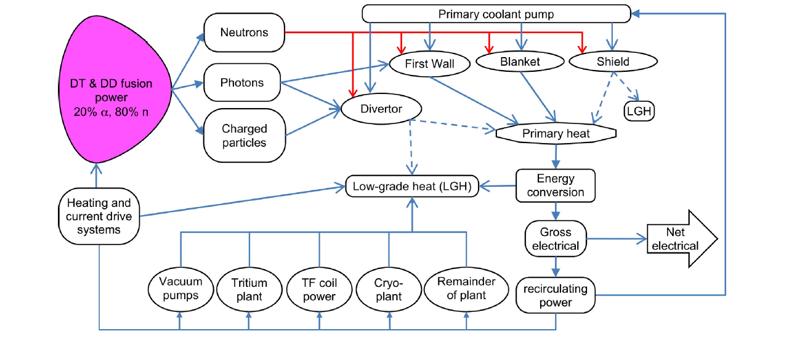
More detailed block diagram of plant power balance

Slide 10
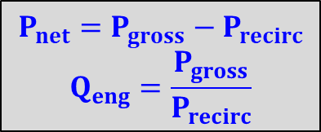
More detailed block diagram of plant power balance
P_{n}
P_{pump}
P_{α}+P_{aux}
P_{aux}
η_{th}
η_{aux}
P_{gross}
P_{aux}/η_{aux}
P_{net}
P_{recirc}
$$P_{net}=P_{gross}−P_{recirc}$$
$$Q_{eng}=\frac{P_{gross}}{P_{recirc}}$$
P_{plant}

Slide 11

Electricity output & gain depend on fusion power & gain, thermal efficiency, and external heating efficiency
$$P_{gross}=η_{th}⋅\left[M_{n}P_{n}+P_{α}+P_{aux}\right]$$
$$P_{gross}=η_{th}⋅Q_{p}⋅P_{aux}⋅ \left[0.8M_{n}+0.2+1/Q_{p} \right]$$
$$P_{recirc}=\frac{P_{aux}}{η_{aux}}+P_{coils}+P_{sub}+ P_{control} +P_{pump}$$
$$P_{recirc}=\frac{P_{aux}}{η_{aux}}\left[1+η_{aux}\frac{P_{coils}}{P_{aux}}+η_{aux}Q_{p}\frac{\left(P_{sub}+ P_{control} +P_{pump}\right)}{P_{fus}}\right]$$
M_{n} ≈1.1, neutron energy multiplier

Slide 12
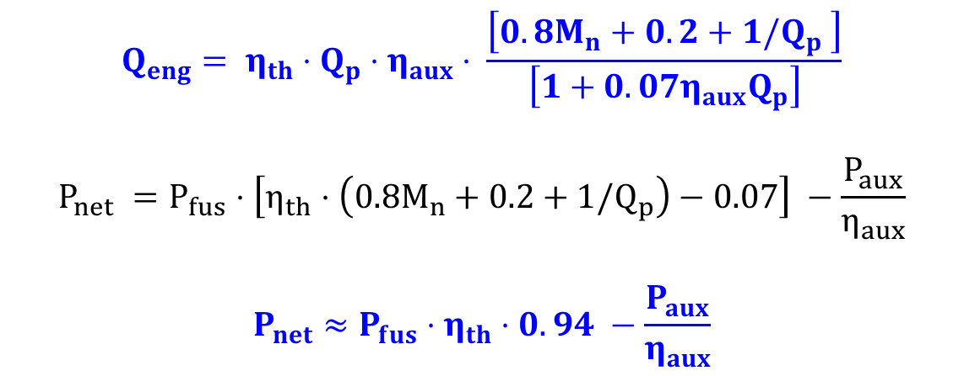
Electricity output & gain depend on fusion power & gain, thermal efficiency, and external heating efficiency
Assuming SC coils (P_{coils}→0), (P_{sub}+P_{con}+P_{pump})/P_{fus}=0.07, M_{n}=1.1
$$Q_{eng}= η_{th}⋅Q_{p}⋅η_{aux}⋅ \frac{\left[0.8M_{n}+0.2+1/Q_{p} \right]}{\left[1+0.07η_{aux}Q_{p}\right]}$$
$$P_{net} =P_{fus}⋅\left[η_{th}⋅\left(0.8M_{n}+0.2+1/Q_{p}\right)−0.07\right] −\frac{P_{aux}}{η_{aux}}$$
$$P_{net}≈P_{fus}⋅η_{th}⋅0.94 −\frac{P_{aux}}{η_{aux}}$$

Slide 13
Cost-of-electricity (COE) and capital cost are also of great interest
Not considering cost metrics here (quantitatively)
There have been multiple attempts to quantify Nth-of-a-kind power plant COE, depending on:
  Capital cost (generally expect $$$ ~ volume or mass) + “learning curve”
  Construction, licensing and operating costs
  Availability
  Waste disposal
  Contingency
Capital cost & development costs driven by risks & unknowns, complexity, engineering, design, prototyping ← hard to quantify

Slide 14
Remainder of this talk: assemble expressions, relations and constraints for P_{fusion}, P_{aux}, Q_{p}, η_{th}, η_{aux}, …
Geometry and size
Nuclear physics
Engineering
Plasma physics
I’ll focus on tokamak, but can do similar for others (stellarators, RFPs, FRCs, MCF, ICF, …) ← good homework problem for you! (and me)
Highlight interactions in 0D systems analysis that influence design points

Slide 15
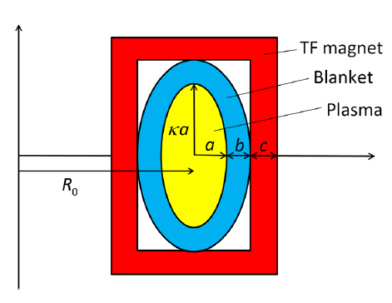
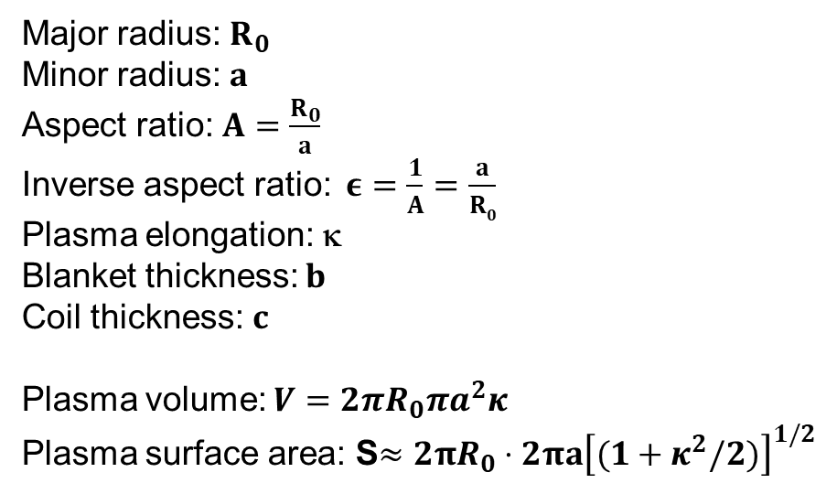
Some geometry definitions
Major radius: $R_{0}$
Minor radius: $a$
Aspect ratio: $A=\frac{R_{0}}{a}$
Inverse aspect ratio: $ε=\frac{1}{A}=\frac{a}{R0}$
Plasma elongation: κ
Blanket thickness: $b$
Coil thickness: $c$
Plasma volume: $V=2πR_{0}πa^{2}κ$
Plasma surface area: S$≈2πR_{0}⋅2πa{\left[(1+κ^{2}/2)\right]}^{1/2}$
I_{TF}

Slide 16
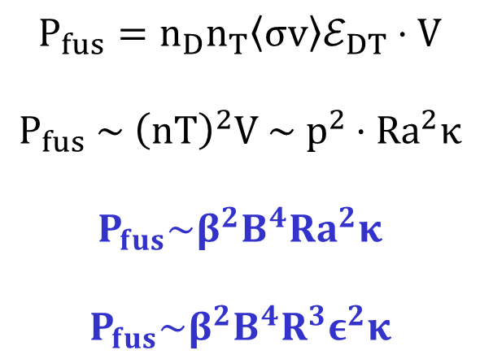
Fusion power depends on pressure and volume
$$P_{fus}=n_{D}n_{T}〈σv〉ℰ_{DT}⋅V$$
$$P_{fus} \sim {\left(nT\right)}^{2}V \sim p^{2}⋅Ra^{2}κ$$
$$P_{fus}\sim β^{2}B^{4}Ra^{2}κ$$
$$P_{fus}\sim β^{2}B^{4}R^{3}ε^{2}κ$$
Only highlighting 0D relations, can also accommodate n, T profile shapes if desired
Cowley, Day 1

Slide 17
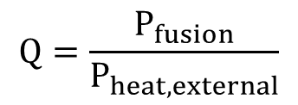
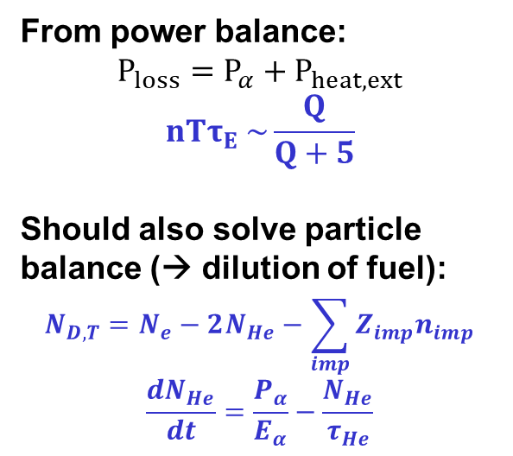

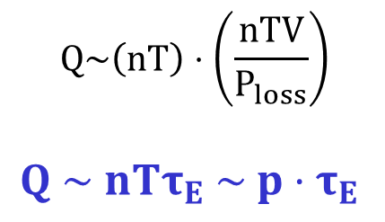
Fusion gain depends on the “triple product” nTτ_{E} (power balance)
Fusion plasma gain
$$Q=\frac{P_{fusion}}{P_{heat,external}}$$
From power balance:
$P_{loss}=P_{α}+P_{heat,ext}$
$$nTτ_{E} \sim \frac{Q}{Q+5}$$
Should also solve particle balance (→ dilution of fuel):
$$N_{D,T}=N_{e}−2N_{He}−\sum_{imp}{Z_{imp}n_{imp}}$$
$$\frac{dN_{He}}{dt}=\frac{P_{α}}{E_{α}}−\frac{N_{He}}{τ_{He}}$$
$$Q\sim \left(nT\right)⋅\left(\frac{nTV}{P_{loss}}\right)$$
$Q \sim nTτ_{E} \sim p{⋅τ}_{E}$
More accurately
Energy confinement time:
$τ_{E}=\frac{stored energy}{rate of energy loss}\sim \frac{nTV}{P_{loss}}$
Cowley, Day 1
Notes:
Also need to account for α helium generated from D-T + impurity species that dilute fuel ions (D,T)

Slide 18
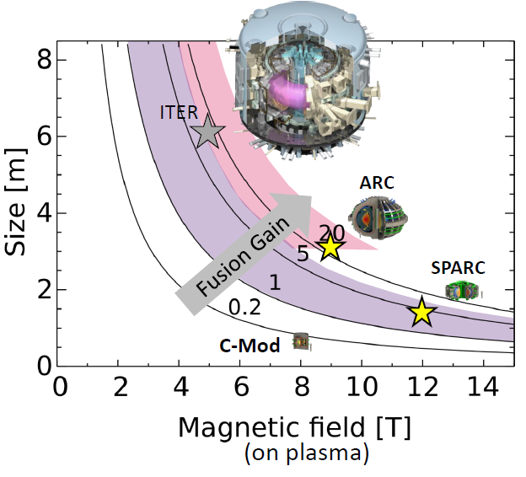

Achievable fusion gain tied to global plasma stability limits, engineering limits and energy confinement time
For fixed geometry assumptions and physics constraints, fusion gain and power set largely by ~ (R₀,B₀)
$$Q \sim nTτ_{E} \sim β⋅B^{2}⋅τ_{E}$$
β = p / (B²/2μ₀) limited by global MHD stability
Magnetic field, B, determined by superconductor technology, mechanical stress & strain limits, and blanket & shield thickness
Energy confinement time, τ_{E}, dominated by turbulent losses, some room for manipulation (flow shear, plasma shape)
Sorbom, Day 5

Slide 19
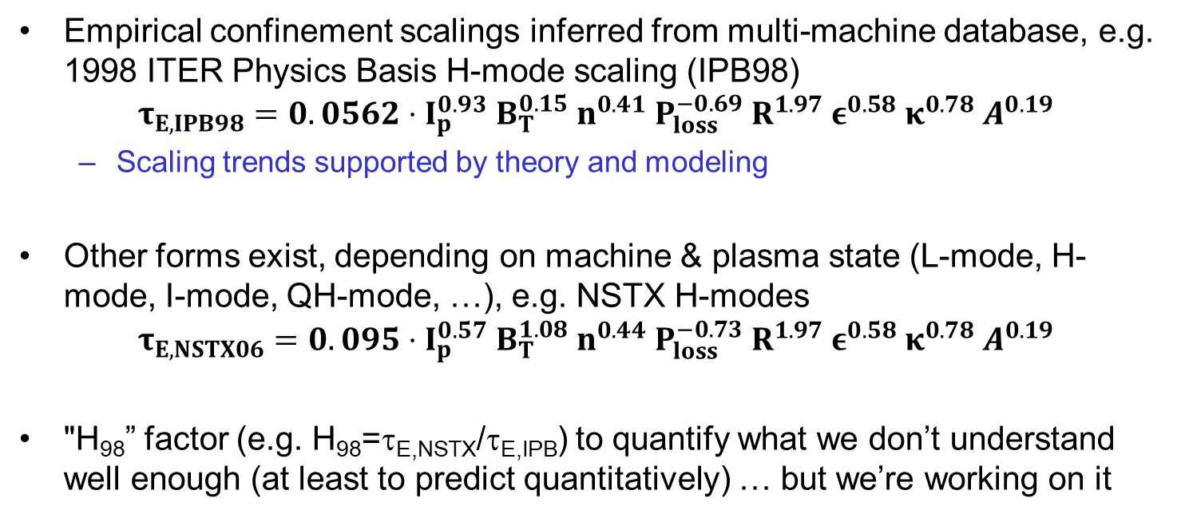
Energy confinement time characterized by various empirical or semi-empirical scalings
Empirical confinement scalings inferred from multi-machine database, e.g. 1998 ITER Physics Basis H-mode scaling (IPB98)
$$τ_{E,IPB98}=0.0562⋅I_{p}^{0.93} B_{T}^{0.15} n^{0.41} P_{loss}^{−0.69} R^{1.97} ε^{0.58} κ^{0.78} A^{0.19}$$
  Scaling trends supported by theory and modeling
Other forms exist, depending on machine & plasma state (L-mode, H-mode, I-mode, QH-mode, …), e.g. NSTX H-modes
$$τ_{E,NSTX06}=0.095⋅I_{p}^{0.57} B_{T}^{1.08} n^{0.44} P_{loss}^{−0.73} R^{1.97} ε^{0.58} κ^{0.78} A^{0.19}$$
"H₉₈” factor (e.g. H₉₈=τ_{E,NSTX}/τ_{E,IPB}) to quantify what we don’t understand well enough (at least to predict quantitatively) … but we’re working on it

Slide 20
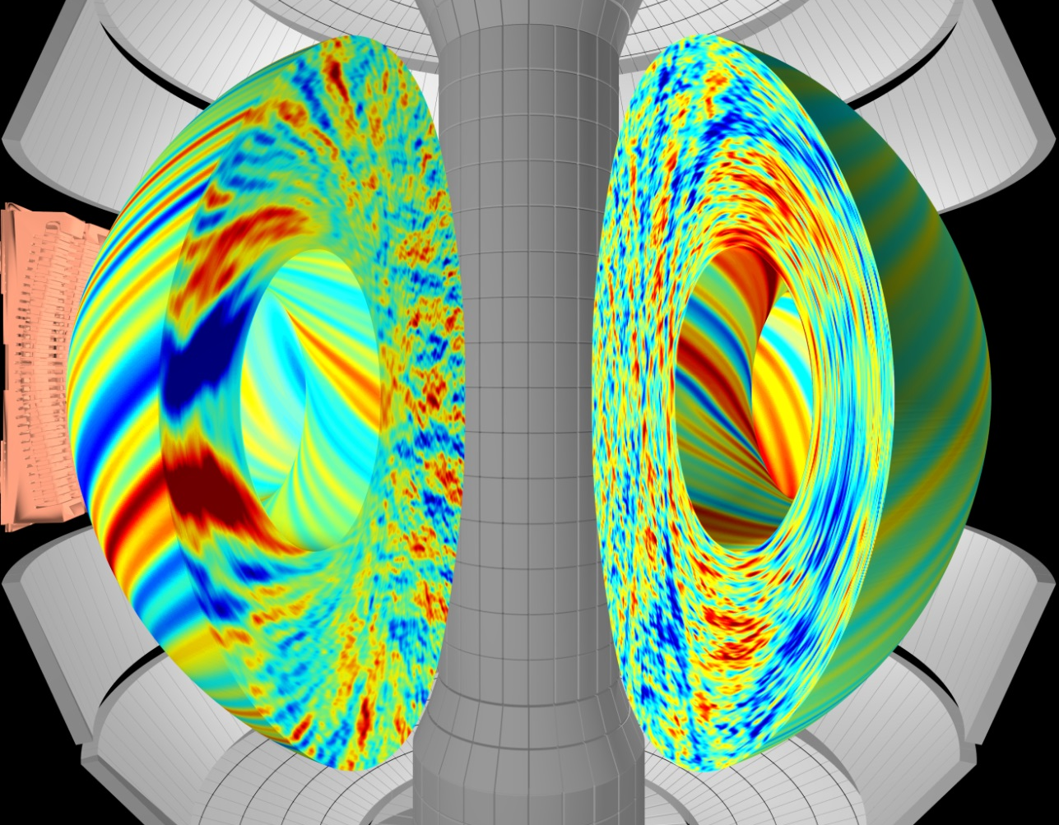

Nature of turbulent losses can vary with machine geometry and operating regimes → opportunities for improved performance
Gyrokinetic simulation of plasma turbulence in NSTX
(this is mostly what I do )
Heat
loss
Visualization: F. Scotti

Slide 21
Global stability (MHD, others) provides a number of constraints
Normalized beta limit: β_{N} = β / (I_{P}/aB) < β_{N,limit} ~ 2-6 (function of R/a, κ, proximity to conducting walls)
  To avoid disruptions or otherwise deleterious effects
Safety factor limit: q* ~ aB_{tor}/RB_{pol} ~ a²B_{tor}/RI_{p}⋅(1+κ²) > 2.5
  To avoid “kink” modes (plasma current is limited for a given toroidal field strength)
Elongation limit: κ_{limit} ~ 1.7-2.5 (function of R/a, plasma inductance)
  To avoid vertical instability
Empirical density limit (“Greenwald limit”): n < n_{GW}= I_{p} / πa² (f_{GW}<1)
  To avoid disruptions
Battaglia, Day 4

Slide 22
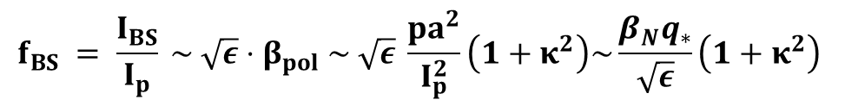
Steady-state tokamaks require 100% non-inductive current
Inductive current drive from central solenoid is limited
Externally driven current (from heating sources) must make up the difference
Luckily, pressure gradient in tokamaks leads to self-generated “bootstrap current” (due to ∇B, curvature drifts + ∇p + collisions)
0 (ideally)
0 (ideally)
$$I_{BS}+I_{CD}+I_{OH}=I_{P} or f_{BS}+f_{CD}+f_{OH}=1$$
$$f_{BS} = \frac{I_{BS}}{I_{p}} \sim \sqrt{ε}⋅β_{pol} \sim \sqrt{ε} \frac{pa^{2}}{I_{p}^{2}}\left(1+κ^{2}\right)\sim \frac{β_{N}q_{∗}}{\sqrt{ε}}\left(1+κ^{2}\right)$$
Battaglia
Day 4

Slide 23
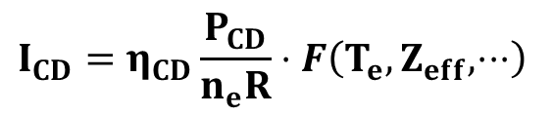

Auxiliary heating required to access high temperatures and to drive current
External heating required to access burning plasma conditions (T~14 keV)
Can also drive current for long-pulse or steady-state tokamak
Each approach has different efficiencies (η_{CD} in units of 10²⁰ MA/MW-m²) and trade-offs
  NBI (η_{CD}≤0.35); well-established, needs vessel openings, impacts tritium breeding ratio (TBR), line-of-sight to neutrons; large, high voltage sources (0.5-1 MeV)
  LHCD (η_{CD}≤0.45); sources available, needs internal antenna, direct exposure to plasma and neutrons
  ECRH (η_{CD}≤0.25); very precise, has density cutoffs (motivates gyrotron developments 200-300 GHz)
$$I_{CD}=η_{CD}\frac{P_{CD}}{n_{e}R}⋅F\left(T_{e}, Z_{eff}, ⋅⋅⋅\right)$$
$$η_{aux}≈0.3−0.4$$
Pinsker, Day 5
Notes:
Some expressions include Te in efficiency equation

Slide 24
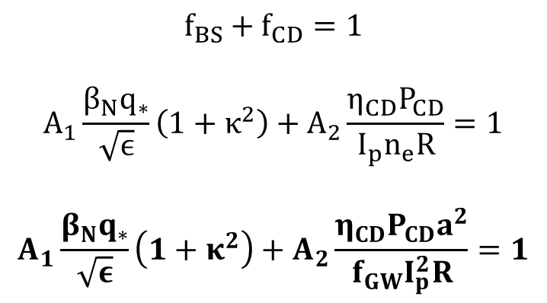
Steady-state current in a tokamak provides a very challenging constraint
$$f_{BS}+f_{CD}=1$$
$$A_{1}\frac{β_{N}q_{∗}}{\sqrt{ϵ}}\left(1+κ^{2}\right)+A_{2}\frac{η_{CD}P_{CD}}{I_{p}n_{e}R}=1$$
$$A_{1}\frac{β_{N}q_{∗}}{\sqrt{ε}}\left(1+κ^{2}\right)+A_{2}\frac{η_{CD}P_{CD}a^{2}}{f_{GW}I_{p}^{2}R}=1$$
f_{GW} ~ constant < 1 (n~I_{P}/a²)
High bootstrap fraction (depending on stability limits), current drive efficiency, and confinement quality (τ_{E}, at I_{p} as low as possible) all needed

Slide 25
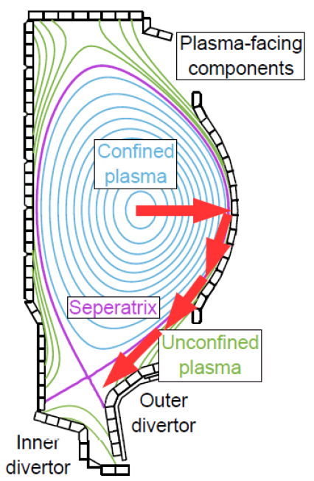

Divertor and first wall material limits constrain exhaust power & particle handling
Must dissipate heat fluxes (steady state, transient) crossing from closed surfaces to open field lines to satisfy material limits
  Solid PFCs, q_{⊥,solid PFC} ≤ 5-10 MW/m²
  Liquid metal PFCs (Li, Sn, SnLi), q_{⊥,LM PFC} ≤ 50 MW/m²
  Vapor shielded PFCs, q_{⊥,vapor PFC} ≤ (???) MW/m²
0D studies often simply evaluate a scrape-off-layer (SOL) heat flux metric to represent the “heat exhaust challenge”
Recent analysis has clarified scaling of impurity seeding (f_{imp}) required to radiatively dissipate (P_{rad,imp}) large Q|| (“detachment”)
  Reinke [2017], Goldston [2017]
Donovan, Lasa, Allain - Day 5

Slide 26
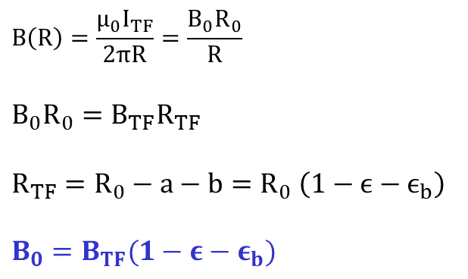
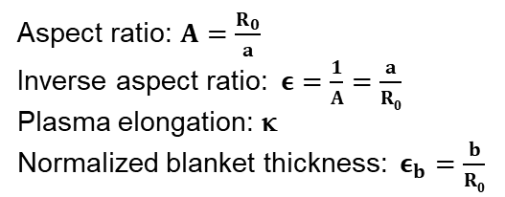
Radial build depends on TF coils, blanket, minor radius and central solenoid
Magnetic field in plasma determined by magnet technology & engineering limits, blanket thickness, and aspect ratio
$$B\left(R\right)=\frac{{μ_{0}I}_{TF}}{2πR}=\frac{B_{0}R_{0}}{R}$$
$$B_{0}R_{0}=B_{TF}R_{TF}$$
$$R_{TF}=R_{0}−a−b=R_{0} \left(1−ϵ−ϵ_{b}\right)$$
$$B_{0}=B_{TF}(1−ε−ε_{b})$$
I_{TF}
Aspect ratio: $A=\frac{R_{0}}{a}$
Inverse aspect ratio: $ε=\frac{1}{A}=\frac{a}{R0}$
Plasma elongation: κ
Normalized blanket thickness: $ε_{b}=\frac{b}{R0}$
Will also need central solenoid for inductively driven current ramp-up

Slide 27
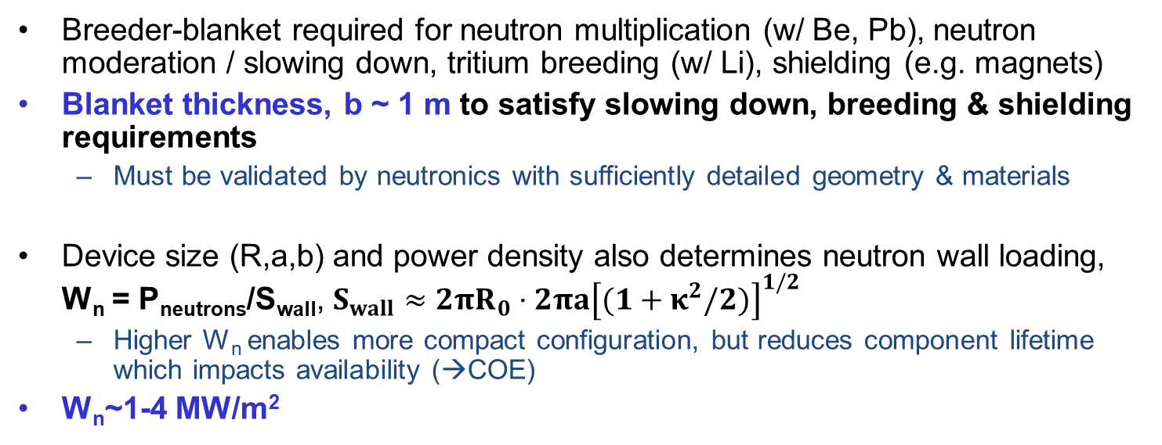
Breeder-blanket thickness requirement largely determined by neutron absorption issues
Breeder-blanket required for neutron multiplication (w/ Be, Pb), neutron moderation / slowing down, tritium breeding (w/ Li), shielding (e.g. magnets)
Blanket thickness, b ~ 1 m to satisfy slowing down, breeding & shielding requirements
  Must be validated by neutronics with sufficiently detailed geometry & materials
Device size (R,a,b) and power density also determines neutron wall loading, W_{n} = P_{neutrons}/S_{wall}, $S_{wall}≈2πR_{0}⋅2πa{\left[(1+κ^{2}/2)\right]}^{1/2}$
  Higher W_{n} enables more compact configuration, but reduces component lifetime which impacts availability (→COE)
W_{n}~1-4 MW/m²
Kessel, Day 6
Garrison, Day 7

Slide 28
Thermal efficiency depends on achievable temperatures in blanket coolant and thermodynamic cycle
A number of blanket concepts proposed with different materials & coolants, affects achievable temperatures and thermal conversion efficiencies
  Sub-critical water cooled (T_{out}~350 °C), η_{th}~0.3 (Rankine / steam cycle)
  Super-critical CO2 (T_{out}~500 °C), η_{th}~0.36-0.45 (Brayton / gas cycle)
  DCLL, He cooled (T_{out}~650 °C), η_{th}~0.45 (Brayton / gas cycle)
  SCLL, He cooled (T_{out}~1000 °C), η_{th}~0.58 (Brayton / gas cycle)
Above, along with other functional aspects, validated by more sophisticated modeling (neutronics for shielding, TBR; MHD for pump power; etc.) - If I ever switched research areas, I’d probably analyze fusion breeder-blankets!
Kessel, Day 6

Slide 29
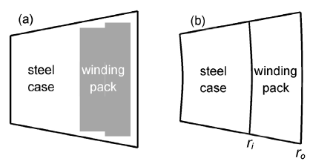
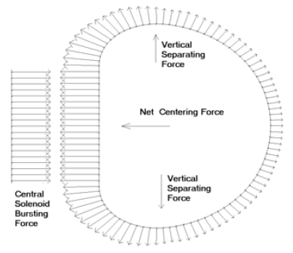
Coil sizing & achievable B₀ field depend on required structural material to support J×B forces + winding pack to support current
TF coil cross section (inboard side)
Coil forces
Need structural support to manage J×B forces
  Vertical TF force
  Centering TF force
  Out-of-plane TF bending force (from interaction with PF coils)
  Central solenoid bursting force
Need sufficient winding pack area to support field, B_{TF} ~ I_{TF} = J_{WP}⋅A_{WP}
P. Titus

Slide 30
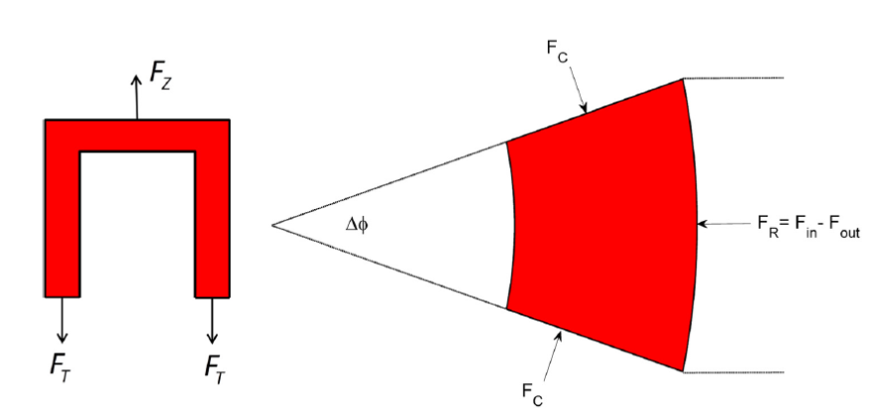
Width of supporting coil structure determined by material stress limits, can limit B_{TF} (B₀)
TF vertical force (F_{Z}~B₀²R₀²) balanced by tensile force (2F_{T} = 2σ_{T}A_{T})
TF centering force (F_{R}~B₀²R₀) balanced by compression from vaulting / wedging (F_{C}=2σ_{C}A_{C})
  Can also “buck” on central solenoid or bucking cylinder (JET)
Coil structure thickness (c_{M}) constrained by total stress limit (e.g. Tresca stress σ_{T}+σ_{C} ≤ σ_{max}~660 MPa for steels)
Must also consider strain limits, σ=E_{young}ε
  E.g. ε<0.3-0.45% for HTS, (Sorbom, Day 5)
More detailed models include discrete number of TF coils (TF ripple from non-axisymmetry), # of WP turns, structural breakdown of WP layers, …
Vertical force
c_{M}
Centering force

Slide 31
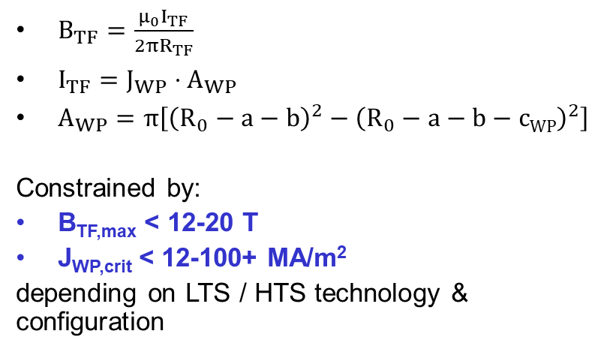
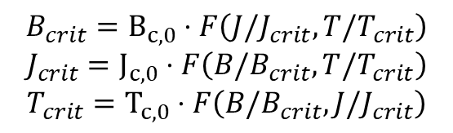
Width of winding pack depends on achievable current density, can limit B_{TF} (B₀)
TF coil cross section (inboard side)
$B_{TF}=\frac{{μ_{0}I}_{TF}}{2πR_{TF}}$
$I_{TF}=J_{WP}⋅A_{WP}$
$A_{WP}=π\left[{\left(R_{0}−a−b\right)}^{2}−{\left(R_{0}−a−b−cWP\right)}^{2}\right]$
Constrained by:
B_{TF,max} < 12-20 T
J_{WP,crit} < 12-100+ MA/m²
depending on LTS / HTS technology & configuration
c_{WP}
B_{TF} @ R_{TF}=R₀-a-b
$$B_{crit}=B_{c,0}⋅F\left(J/J_{crit},T/T_{crit}\right)$$
$$J_{crit}=J_{c,0}⋅F\left(B/B_{crit},T/T_{crit}\right)$$
$$T_{crit}=T_{c,0}⋅F\left(B/B_{crit},J/J_{crit}\right)$$
Sorbom
Day 5
Notes:
There have also been conceptual designs for copper reactors (low-A), with extremely aggressive physics assumptions that enable low recirculating power

Slide 32
Let’s put it all together to identify integrated self-consistent solutions
Choose targets and constraints
Solve remaining equations
Test sensitivity of solution to parameter variations
First consider power plant (P_{e,net}=1000 MWe)
Then pilot plant (P_{e,net} ~ 100-200 MWe)

Slide 33
Power plant example: P_{e,net}=1000 MWe , steady-state using well-established (~conservative) physics limits [Freidberg tutorial]
Choose a target power: P_{E}=1,000 MWe, f_{recirc}≤0.15 (f_{CD}=0.1, η_{aux}=0.4 →P_{aux}), η_{th}=0.4, T_{plasma}=14 keV
Choose geometry: R/a=4, κ=1.7, W_{n}~P_{α}/Area = 4 MW/m²
Solve for: R, a, pressure, density
Choose blanket thickness: b_{blanket}=1.2 m (n-moderation, T-breeding)
Choose coil technology: Nb₃Sn coil model (B_{TF,crit}=13 T, J_{WP,crit}=20 MA/m², σ_{max}=600 MPa)
Solve for: coil thickness & B₀ (from radial build)
Solve for: confinement time and required current (P_{loss}≈P_{α} → τ_{E} → I_{P})
Solve for: externally driven current (assumed LHCD, η_{CD} ≈ 0.43 MA/MW⋅m²)
Evaluate stability and criteria:
  (1) beta limit (β_{N}<2.8)
  (2) kink limit (q*>2)
  (3) greenwald density limit (n/n_{GW}<1)
  (4) 100% non-inductive (f_{BS}+f_{CD}=1)

Slide 34
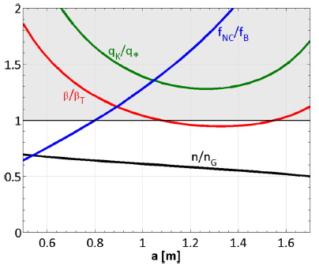
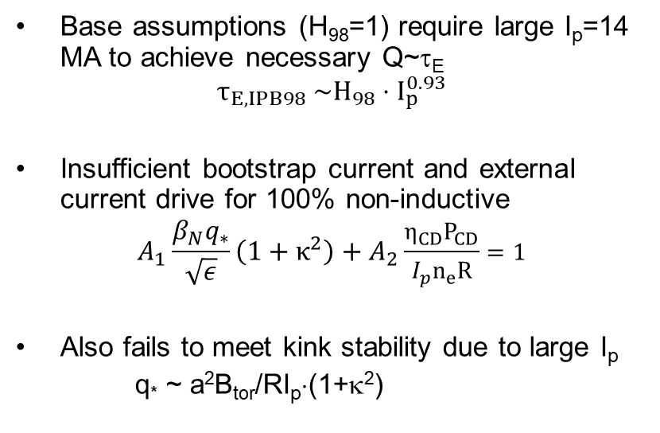
Not possible to satisfy 100% non-inductive or kink stability limit due to large required current
Base case: a=1.34 m, R=5.34 m
Base assumptions (H₉₈=1) require large I_{p}=14 MA to achieve necessary Q~τ_{E}
$$τ_{E,IPB98} \sim H_{98}⋅I_{p}^{0.93}$$
Insufficient bootstrap current and external current drive for 100% non-inductive
$$A_{1}\frac{β_{N}q_{∗}}{\sqrt{ε}}\left(1+κ^{2}\right)+A_{2}\frac{η_{CD}P_{CD}}{I_{p}n_{e}R}=1$$
Also fails to meet kink stability due to large I_{p}
q* ~ a²B_{tor}/RI_{p}⋅(1+κ²)
bad
good

Slide 35
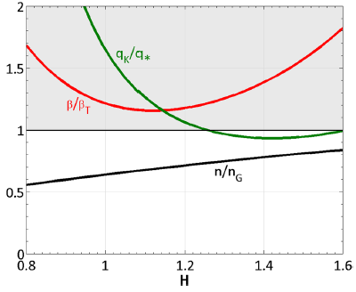
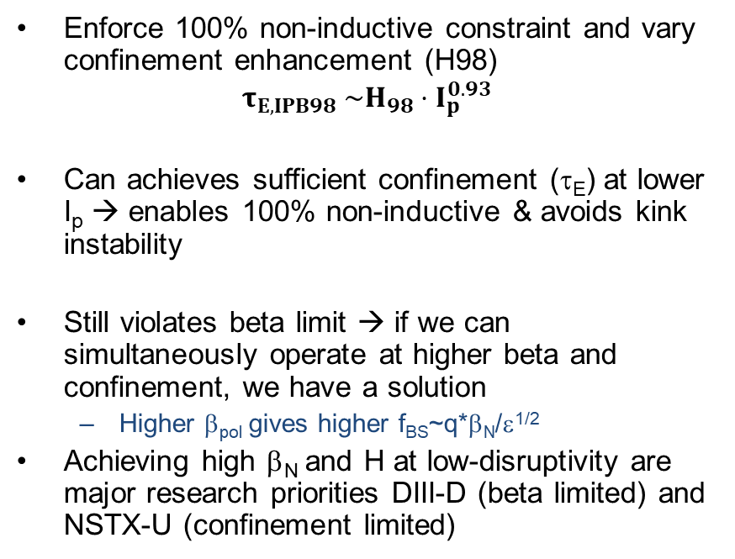
Enhanced confinement enables 100% non-inductive scenario
Enforce 100% non-inductive constraint and vary confinement enhancement (H98)
$$τ_{E,IPB98} \sim H_{98}⋅I_{p}^{0.93}$$
Can achieves sufficient confinement (τ_{E}) at lower I_{p} → enables 100% non-inductive & avoids kink instability
Still violates beta limit → if we can simultaneously operate at higher beta and confinement, we have a solution
  Higher β_{pol} gives higher f_{BS}~q*β_{N}/ε^{1/2}
Achieving high β_{N} and H at low-disruptivity are major research priorities DIII-D (beta limited) and NSTX-U (confinement limited)
bad
good

Slide 36
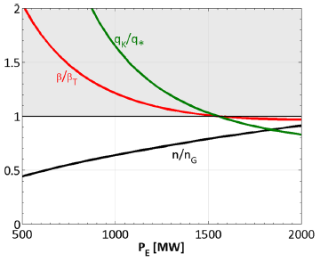
Higher capacity enables 100% non-inductive, eventually satisfying all stability constraints at very large scale
Favorable for COE, but not for capital cost
bad
good

Slide 37
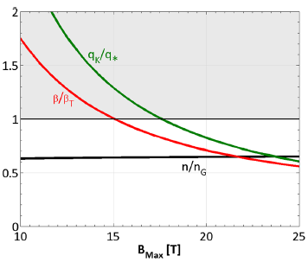
Higher field on-axis satisfies all constraints
More aggressive technology (e.g HTS, Sorbom, Day 5) relaxes most plasma physics challenges
  Avoids β and q* kink limit
Higher power density & wall loading
Exacerbates boundary heat flux mitigation challenge, Q|| = PB/R
  But radiative detachment solution for plasma exhaust also scales with B [Reinke, 2017]
bad
good

Slide 38
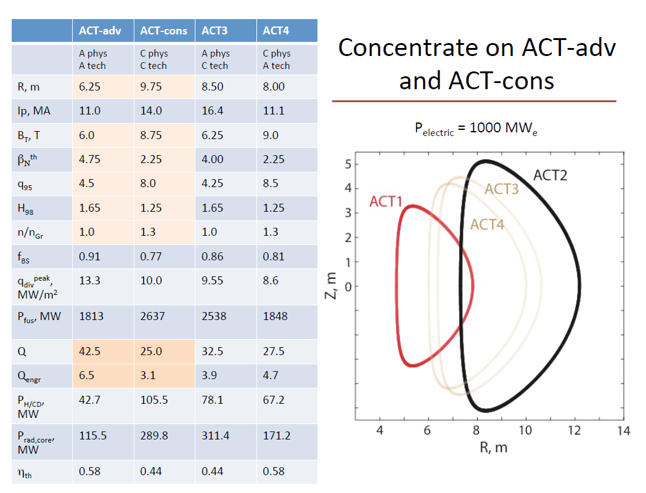
ARIES-ACT study performed trade study in assumed physics and technology limits
“ACT”: Advanced and Conservative Tokamak power plant study
  1000 MWe
  100% non-inductive
  PbLi breeder
  Nb₃Sn
  A=4, κ=2.2
ACT1: More aggressive physics and technology
  Much smaller (1000 MWe at size of ITER)
  Requires elevated confinement (H₉₈=1.65) and good stability (β_{N}=4.75)
ACT2: Conservative physics and technology
  Larger ~ EU-DEMO, higher I_{p} and P_{aux}, lower f_{BS}
Kessel et al. (2015)

Slide 39
More recent focus to target pilot plant parameters
Lower capacity, P_{net}~100-200 MWe (COE not the immediate concern)
  Don’t need to demonstrate 100% of all “essential criteria”, as long as solutions perceived to scale
Target aggressive technology and physics to push for pilot plant at low capital cost (e.g. compact tokamaks, stellarators)

Slide 40
High field HTS magnets enables smaller, net electric pilot plants (ARC design)
Targeting fixed fusion power: P_{fusion} = 500 MW
HTS coil properties: B_{max}=18 T
Shielding: Δ_{b}=0.5 m (<1 m blankets)
Constraints: P_{fusion} = 500 MW, Q_{P}>25, q*>2.2, β_{N}=<3, RF heating cutoff, W_{n}>2.5 MW/m²
Enforcing 100% non-inductive → P_{net}=190 MW, f_{BS}=0.63
  Still requires elevated confinement (H₉₈~1.8) for steady-state

Slide 41
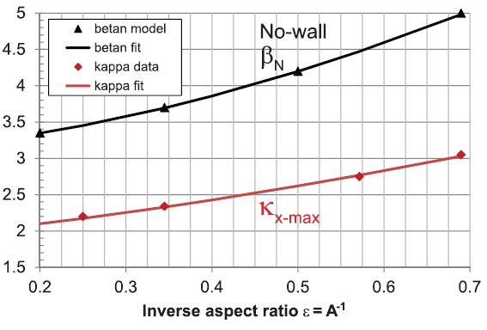

Lower aspect ratio provides opportunities to achieve improved plasma performance
Lower A=R/a=1/ε can access larger stable β_{N} and κ
Re-write fusion power & gain in terms of B_{TF}, R₀, ε and β_{N}, κ stability parameters
P_{fus} ~ B_{TF}⁴R₀³ ⋅ ε³(1-ε-b/R₀)⁴ ⋅ β_{N}⁴κ⁴ ⋅ (C_{BS}/f_{BS})²
(Petty 08 τ_{E} scaling)

Slide 42
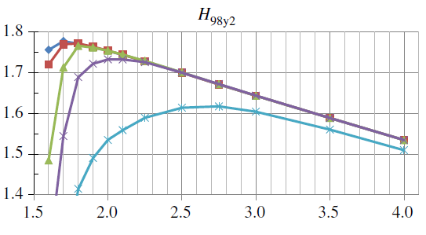
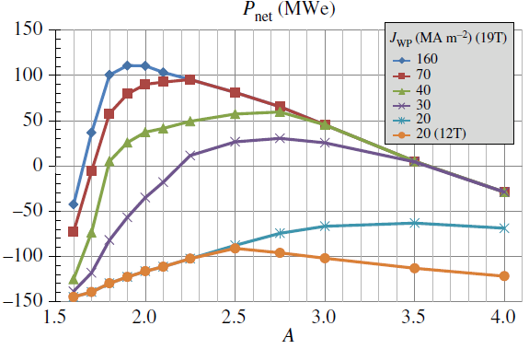
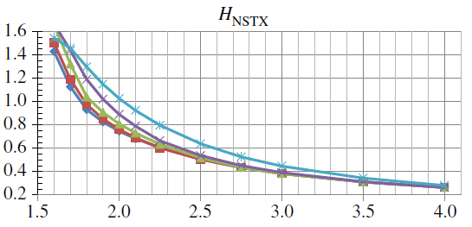
P_{net} maximized at lower A~2-2.4 if coil current density (J_{WP}) high enough and shielding not too thick
Required confinement enhancement H₉₈ is still large
Minimal confinement enhancement if NSTX confinement scaling remains ← key NSTX-U research priority

Slide 43
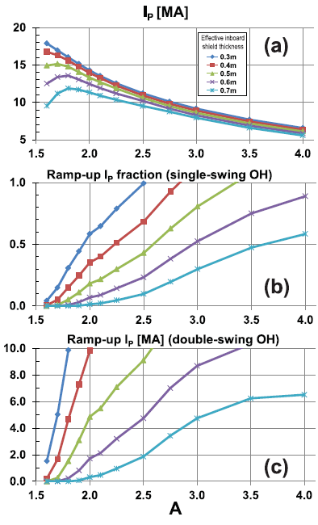
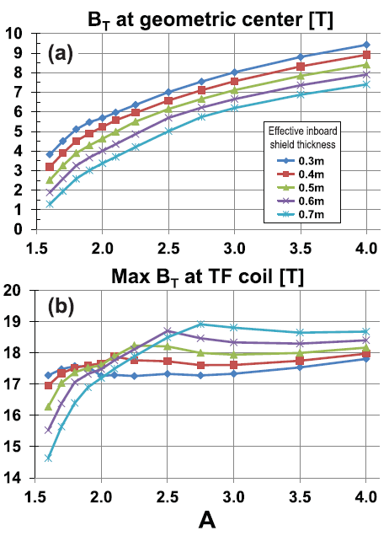
Achievable B_{TF,max} eventually drops with aspect ratio; progressively less central solenoid flux available for ramp-up

Slide 44
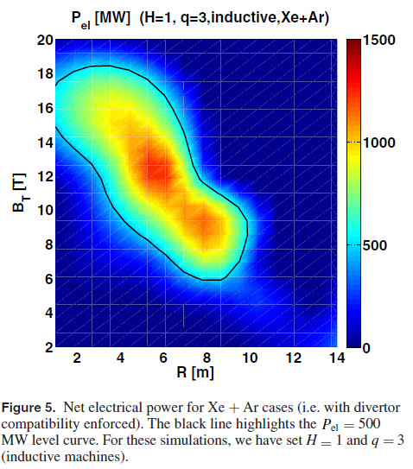
Attempts to self-consistently include divertor / plasma heat exhaust solution have recently been made
$$P_{α}+P_{aux}=P_{loss,conduction}+P_{rad,Brehm}+P_{rad,sync}+P_{rad,imp}$$
Additional constraints on required impurity seeding for radiative divertor (detachment) provide upper bound on (R₀,B₀)
  Plus synchrotron radiation increases at higher B field
Siccinio, Nucl. Fusion 58, 016032 (2018)

Slide 45
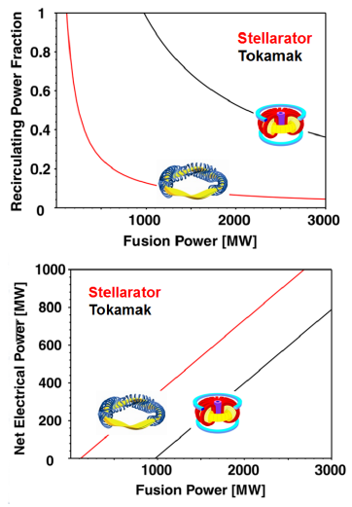
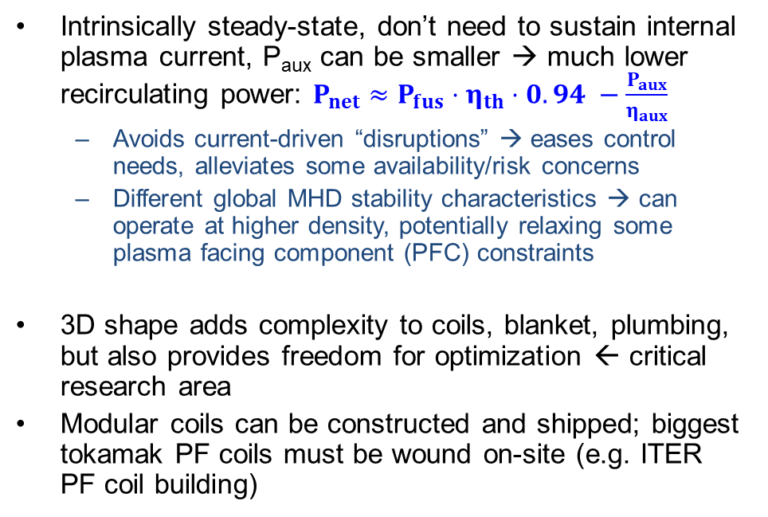
Stellarators offer path to steady-state P_{net}>0, Q_{eng}>1 at lower P_{recirc} & P_{fusion}
Intrinsically steady-state, don’t need to sustain internal plasma current, P_{aux} can be smaller → much lower recirculating power: $P_{net}≈P_{fus}⋅η_{th}⋅0.94 −\frac{P_{aux}}{η_{aux}}$
  Avoids current-driven “disruptions” → eases control needs, alleviates some availability/risk concerns
  Different global MHD stability characteristics → can operate at higher density, potentially relaxing some plasma facing component (PFC) constraints
3D shape adds complexity to coils, blanket, plumbing, but also provides freedom for optimization ← critical research area
Modular coils can be constructed and shipped; biggest tokamak PF coils must be wound on-site (e.g. ITER PF coil building)
Bader
Day 4
Zohm

Slide 46
Summary
Conceptual power/pilot plant design studies must consider self-consistent integrated solution including nuclear, engineering and plasma physics constraints
  Neutron absorption, blanket concepts, superconductor technology, current drive efficiencies, confinement, stability limits, …
Studies have been performed highlighting key sensitivities that influence performance → motivates critical, innovative research in US & worldwide fusion programs

Slide 47
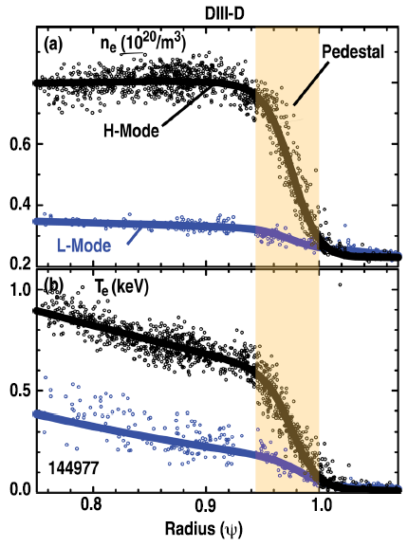
Tokamak plasmas exhibit a few different operating regimes
L-mode (“low” confinement mode)
H-mode (“high” confinement mode): with sufficient power passing through the edge, an edge transport barrier spontaneously develops → considerably improved confinement
  There are others (QH-mode, I-mode, VH-mode, EP-H mode, …)
Access to H-mode depends on a “L-H threshold power”, P_{L/H}~0.049⋅B^{0.80}n^{0.72}S^{0.94}
Power crossing the last closed flux surface (P_{sep} = P_{conduction,loss} – P_{rad}) must be bigger then P_{L/H} to remain in H-mode: P_{sep} > P_{L/H}

Slide 48

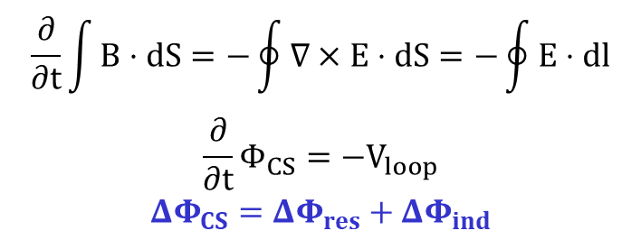
Inductive current drive (for ramp-up and “flat top” in tokamaks) requires a central solenoid (CS)
$$\frac{∂}{∂t}\int{B⋅dS}=−\oint{∇×E⋅dS}=−\oint{E⋅dl}$$
$$\frac{∂}{∂t}Φ_{CS}=−V_{loop}$$
$${ΔΦ}_{CS}=ΔΦ_{res}+ΔΦ_{ind}$$
Can estimate how much central solenoid flux ΔΦ_{CS} (V-s) required to ramp-up plasma current (prior to 100% non-inductive flat-top):
  Resistivity: ΔΦ_{res} ~ μ₀I_{p}R₀
  Self-inductance: ΔΦ_{ind} ~ L_{P}I_{p}
Motivates research on non-inductive plasma break-down and current ramp-up schemes (Diem, Day 2; Battaglia, Day 4)
$$ΔΦ_{CS}\sim I_{p}$$

Slide 49
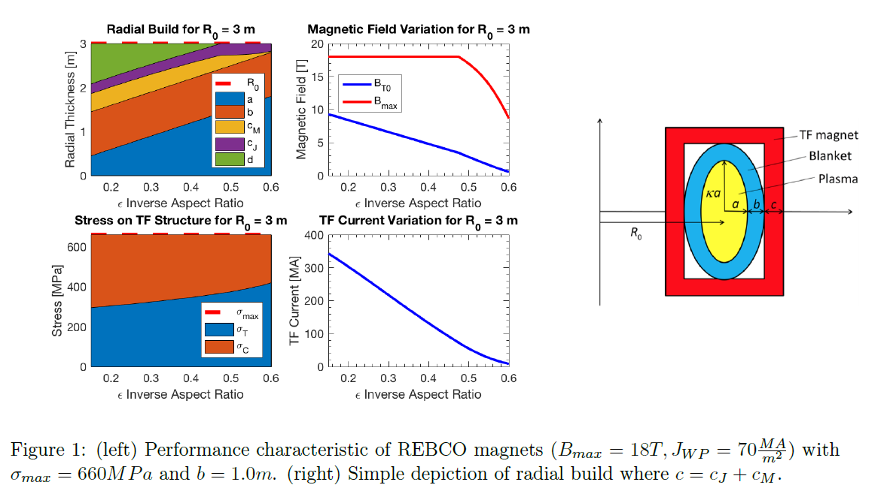
Shrinking aspect ratio ultimately constrained by stress limits, current density limits, central solenoid requirements
C. Perks, SULI 2018 project

